Slide 1

Capstone Project-RETAIL ANALYTICS

Slide 2
OVERVIEW
Valuable Insights: The business purpose for the given dataset has been driven deeply by using visualization and dashboards. It gives the overall strategy to build the foundation in market.
Improvement Focus: The visualization which are being created helps to retrieve the fundamental growth of packages of dataset. It shows the improvement through the every region and category for overall time period.
Evaluation of Effectiveness: The dashboard gives you various aspect to work on and also help the visualize the suitable insights. It gives proper guidance to reach the every value based on sales. Thus to get the proper feedback throughout the research and involvement of process evaluation is very effective. And also this sight helps to make data-driven decisions based on the evaluation.
Trend Identification: By tracking the information and studying it carefully we can predict the previous sales using the data. The dashboards visualization helps us to make the study more predictive it helps identify and reveal various trends of history of sales, orders and consumption of various product in each category. This trend identification help to predict the future productivity of sales and product.
Comprehensive Understanding: The feature of power bi visualization gives a comprehensive idea of sales using various operations. The best feature of the dashboards is they give valuable insights using various aspect thus it helps to understand comprehensively.
Sales Analysis
Product Analysis
Order Analysis
Customer Analysis
Geographic Analysis

Slide 3



Objective: Our project objectives include improving inventory turnover, optimizing product pricing, identifying sales growth opportunities, and enhancing the overall customer shopping experience.
Goal: The primary aim of this retail analytics project is to enhance business performance and customer satisfaction through data-driven decision-making. We seek to leverage Power BI and Excel to gain insights into sales trends, inventory management, and customer behaviour.
Analysis Scope : Our analysis covers a wide range of aspects, including sales data, customer demographics, product performance, and market trends. We will also explore seasonality, promotions, and geographic variations in customer behaviour.

Slide 4



Insights: Through the application of advanced analytics techniques, we have uncovered actionable insights. These include identifying high-demand product categories, understanding customer preferences, and pinpointing underperforming store locations.
Recommendations: Based on our analysis, we recommend strategies such as dynamic pricing, targeted marketing campaigns, and optimizing inventory levels to improve profitability. Additionally, we suggest enhancing the in-store layout and expanding the product offerings in certain categories.
Report & Presentation: The report provides a comprehensive overview of our findings, methodologies, and recommendations. It includes visually appealing Power BI dashboards, data visualizations, and Excel spreadsheets for in-depth analysis. The presentation summarizes key findings and recommendations, offering a concise overview for stakeholders.

Slide 5
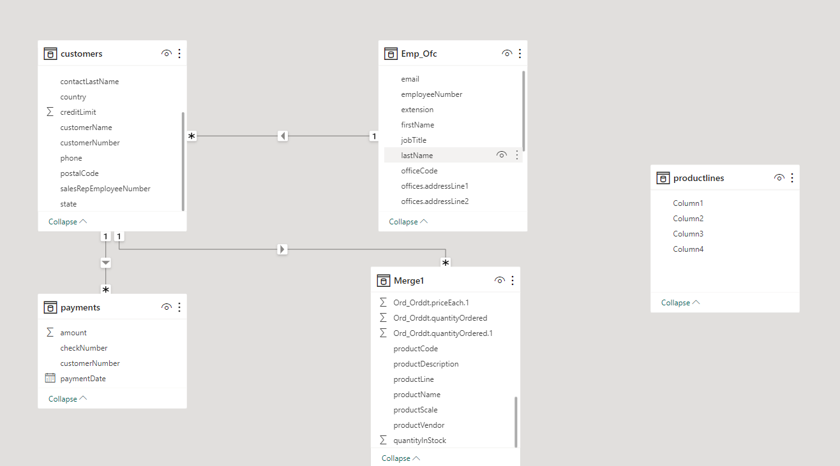
ER DIAGRAM(Power BI)

Slide 6
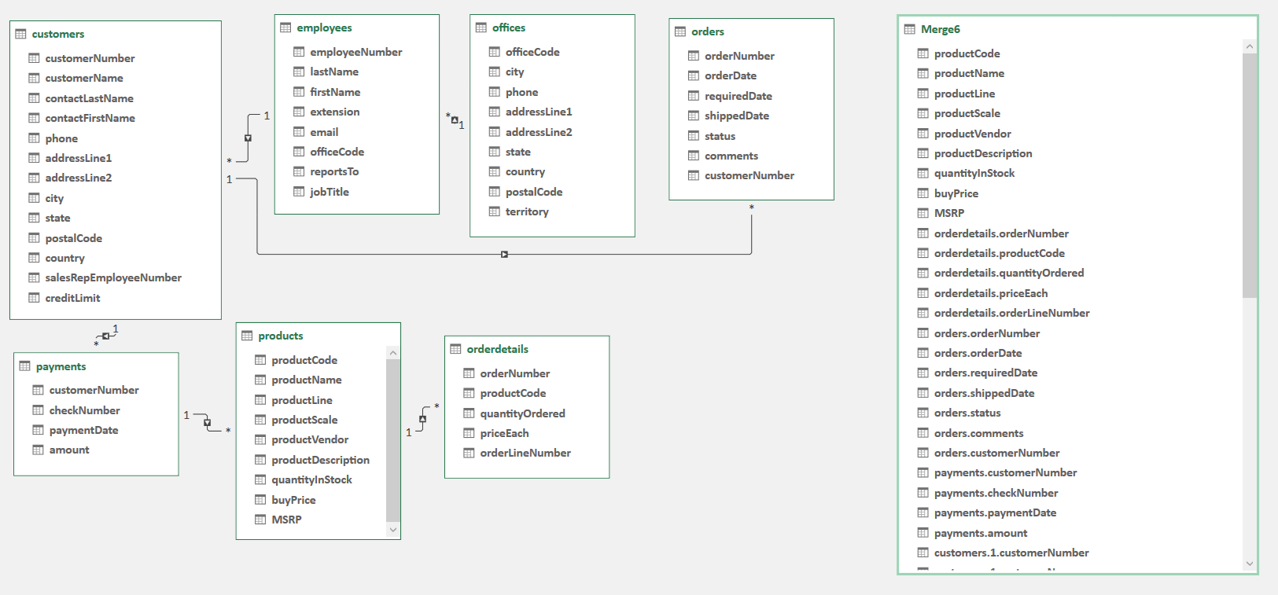
ER DIAGRAM(EDA)

Slide 7

Power BI Problem Statements

Slide 8
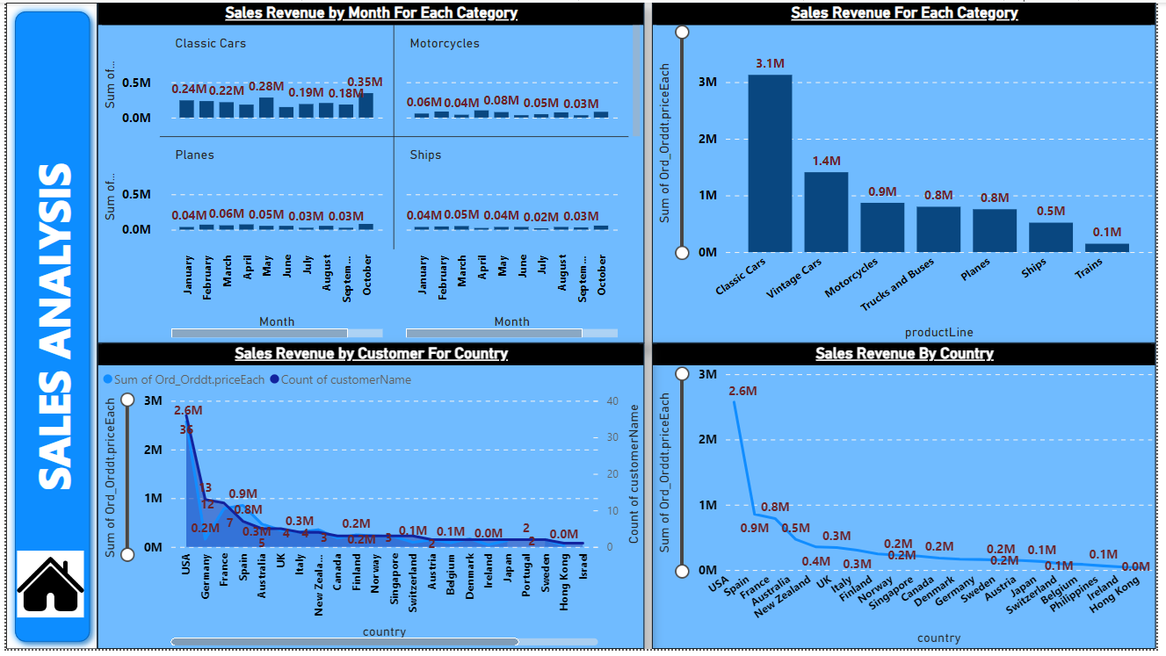

Slide 9
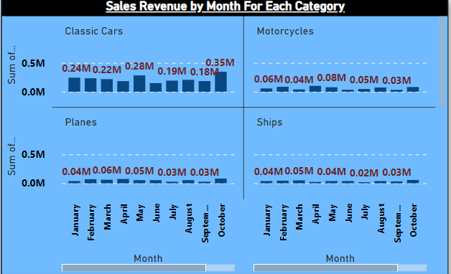

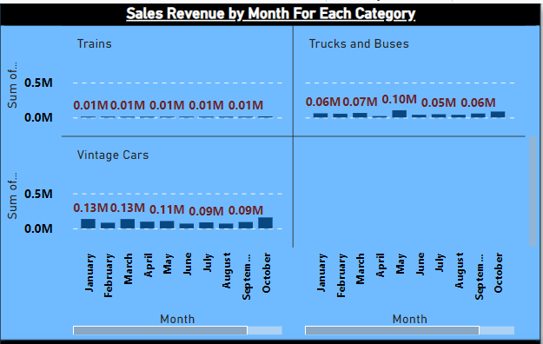
How does monthly revenue vary across different product categories?
By delving into the report and meticulously comparing the data across categories, one compelling fact rises above all: Cars reign supreme, outshining every other category by a substantial margin. This revelation isn't just a statistic; it's a crystal-clear testament to the sheer transparency of our revenue breakdown by categories.
In the world of sales, where complexity often obscures clarity, our data shines a spotlight on the undeniable star of the show—Cars. This remarkable insight invites us to streamline our focus, directing our efforts where the light shines brightest.
In the simplest terms, our revenue story can be summarized in just two words: Cars dominate. And by harnessing this clarity, we hold the key to unlocking unparalleled success in our strategic pursuits.

Slide 10
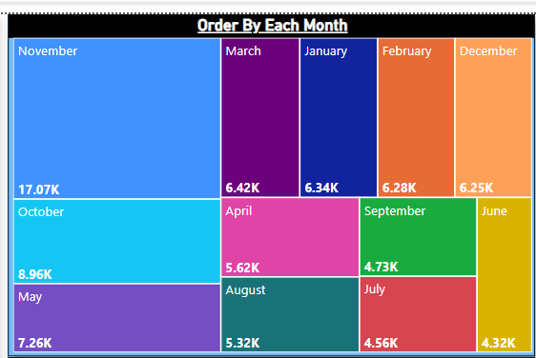
What is the trend in customer order volume over the past year?
Within the confines of this report, a tantalizing glimpse into the future emerges as we decipher the patterns ingrained in years of meticulous data. Like a crystal ball, our analysis reveals a November phenomenon that transcends the ordinary—this month stands as a beacon of heightened activity, with order volumes that eclipse all others. It's not merely a coincidence but a testament to the predictive power of our insights, offering a tantalizing preview of what lies ahead. As we embark on this journey, we are armed with the knowledge to harness these trends and steer our course toward greater success in the years to come.

Slide 11
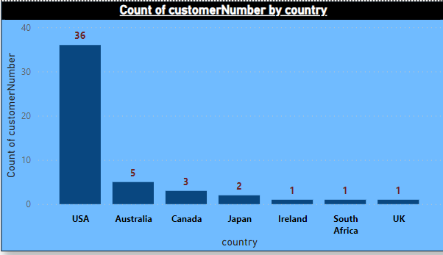
How does the sales performance of top customers compare to the rest?
In our quest for strategic excellence, a striking revelation emerges: the crown jewels of our customer base reside in the mighty nations of the USA, Australia, and Canada. These powerhouse countries command a lion's share of our orders, illuminating their significance in our business landscape.
Yet, as we delve deeper into the treasure trove of data, a world of untapped potential beckons from the other countries. Their orders may be fewer in number, but their collective impact is nothing short of transformative. It's akin to unlocking a cache of hidden gems, waiting to be polished into valuable insights that can fuel our growth and global reach.
With this knowledge in hand, we embark on a precision-targeted mission to nurture and expand our customer base in these unsung territories. By tailoring our strategies to suit the unique needs and preferences of these diverse markets, we open the door to a future brimming with untold opportunities.
The world is our canvas, and by painting our success story across a broader spectrum of countries, we are poised to create a masterpiece that transcends borders and propels our business to new heights.

Slide 12
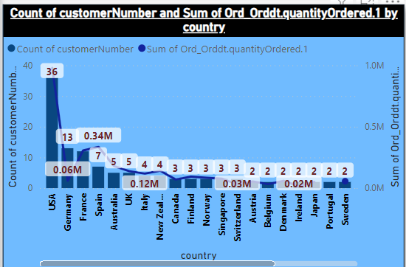
How does the sales performance of top customers compare to the rest?
From the insightful analysis and comprehensive report, a vivid portrait of market trends comes into focus, offering a compass to navigate our journey forward. The graph, a reflection of our data-driven prowess, unveils the stars of our show: the USA, Germany, France, Spain, and Australia. These nations stand tall with their commanding order volumes, painting a compelling picture of our current market landscape.
However, as we gaze beyond the horizon, the untapped potential of the rest of the world beckons us. Like undiscovered treasure troves, these regions are ripe for exploration and strategic engagement. Our plan is not merely to seize the present, but to shape the future.

Slide 13
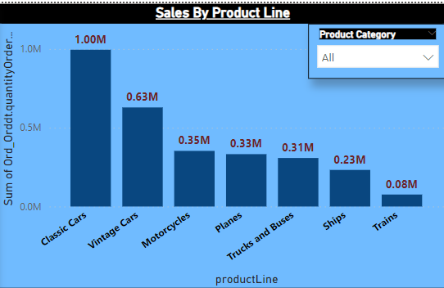
What is the distribution of product sales across different product lines?
In our analysis and report, one resounding truth emerges: Cars reign supreme, towering above all other categories in terms of sales. This fact stands as a beacon of clarity, guiding our strategic decisions with unwavering simplicity. In essence, the road to success is paved with the dominance of Cars in our revenue landscape.

Slide 14
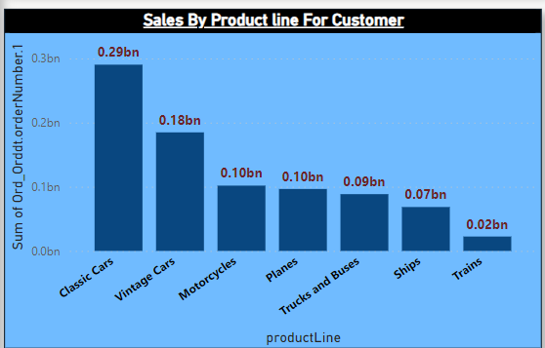
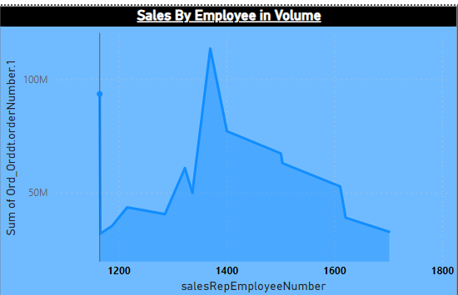
What is the distribution of product sales across different product lines?
In the visual landscape before us, a striking revelation unfolds: Classic Cars emerge as the unrivaled champions, casting their brilliance upon our sales data. Yet, in the symphony of sales, other categories harmoniously contribute, driven by the expertise of our exceptional employees.
It's as if Classic Cars possess a gravitational pull, drawing customers with a magnetic allure. This singular category, with its timeless appeal, stands tall as a symbol of excellence. But let us not forget the stellar role played by our dedicated employees, who orchestrate remarkable sales across the spectrum. Their expertise transcends categories, weaving a tale of success that is both diverse and compelling. In this juxtaposition, we find the essence of our achievement—an elegant balance between the allure of Classic Cars and the exceptional efforts of our team. It's a symphony of success that resonates with both classic charm and modern prowess.

Slide 15
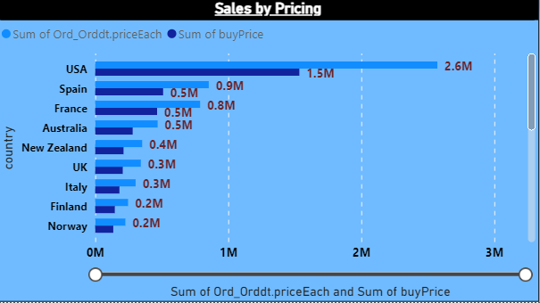
How does product pricing impact sales volume?
As we immerse ourselves in the depths of our report, a powerful revelation surfaces: product pricing casts a profound spell on our sales, especially in the grand domains of our top-tier countries. This impact unfurls a tapestry of insight, inviting us to envision a world where high-priced products reign supreme.
In these top countries, where the sales crescendo to remarkable heights, we witness the transformative influence of pricing strategies. It's akin to a symphony where premium products take center stage, captivating discerning customers with their allure.
The lesson is crystal clear: the potent alchemy of pricing not only elevates sales but also paints a vibrant portrait of opportunity. It beckons us to visualize a future where high-priced offerings hold sway, fostering a narrative of elevated revenue and boundless potential.

Slide 16
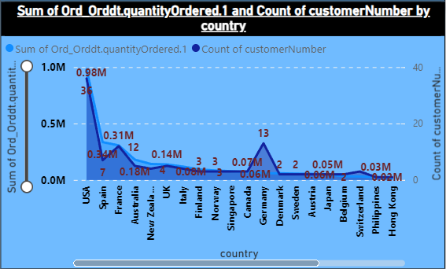
What is the distribution of customers across different demographic segments?
Within the pages of our report, a captivating narrative of customer orders unfolds—a tale that places the spotlight firmly on countries like the USA, Germany, and France. These nations emerge as our key protagonists, commanding the stage with a flurry of orders that resonate with productivity.
In this dramatic portrayal of data, we find that these customer orders paint a portrait of prosperity. It's as if the very essence of productivity flows through the veins of these nations, fueling our success story.
Their significance is undeniable, and as we cast our gaze forward, we are compelled to envision a future where their contributions continue to steer the ship of productivity, propelling us toward even greater heights.

Slide 17
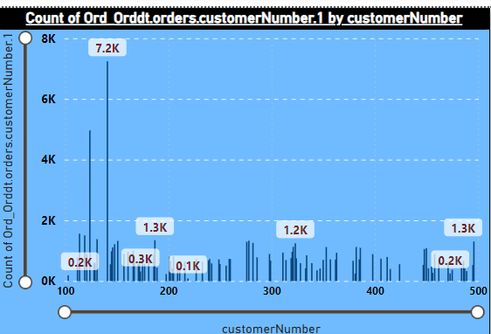
What is the distribution of customers across different demographic segments?
Our analysis unveils a captivating pattern: Customers numbered from 100 to 200 stand out as the torchbearers of orders, their impact far-reaching. What's more, these astute buyers predominantly hail from the USA, a market giant that claims a commanding 35% share, with the rest comprising "others."
In this geographic ballet, the USA takes center stage, with our most influential customers orchestrating their orders from this thriving market. It's a narrative of significance, where customer numbers and geographical prowess converge, setting the stage for remarkable insights and strategic directions.

Slide 18
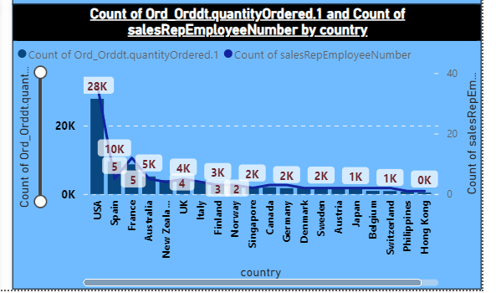
What is the distribution of customers across different demographic segments?
Our comprehensive analysis and report paint a vivid picture: Customers within the EMEA market emerge as the torchbearers of order productivity, outshining their counterparts in other markets. In this spirited arena, employees engage in a dynamic competition fueled by the region's soaring sales figures.
It's a captivating narrative of market dominance and employee excellence, where the EMEA market stands as a beacon of opportunity. As we navigate these rich insights, we're poised to harness the potential of this thriving market and foster a culture of healthy competition among our employees, all under the banner of remarkable success.

Slide 19
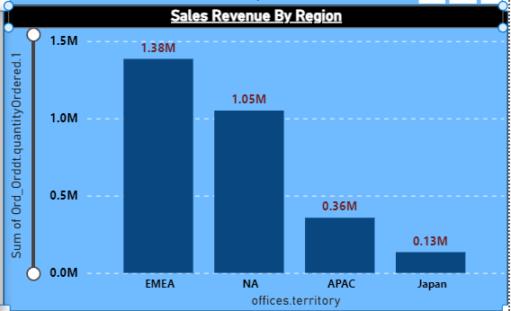
What are the top regions in terms of sales revenue?
Our analysis unveils a compelling narrative: The EMEA (Europe, Middle East, and Africa) and NA (North America) markets collectively command a staggering 70% share of our sales volume. In this dynamic landscape, order quantities from these powerhouse regions surge well beyond the horizon, pointing resolutely toward the future.
This undeniable trend guides our strategic compass, urging us to set sail towards the fertile shores of the EMEA and NA markets. With their unwavering growth potential, these markets are our lodestar, guiding our course toward a future brimming with opportunities and customer engagement.

Slide 20
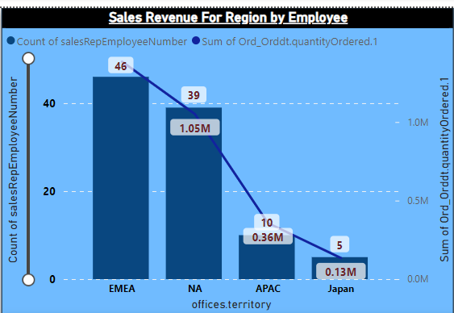
What are the top regions in terms of sales revenue?
In our meticulous analysis, a compelling narrative unfolds: the EMEA and NA markets reign supreme, jointly commanding an impressive 70% share of our sales volume, while the remaining markets contribute 30%. This striking distribution ripples across order quantity and employee engagement, solidifying the notion that our future trends are inexorably tied to the EMEA and NA markets.
The data speaks with conviction—the heart of our strategy lies in fostering relationships and seizing opportunities within these robust markets. As we embrace this powerful insight, we embark on a journey to capture the hearts and minds of customers in the EMEA and NA regions, setting the stage for an even brighter future.

Slide 21
How does the performance of sales employees vary across different regions?
In our meticulous analysis, a compelling narrative unfolds: the EMEA and NA markets reign supreme, jointly commanding an impressive 70% share of our sales volume, while the remaining markets contribute 30%. This striking distribution ripples across order quantity and employee engagement, solidifying the notion that our future trends are inexorably tied to the EMEA and NA markets.
The data speaks with conviction—the heart of our strategy lies in fostering relationships and seizing opportunities within these robust markets. As we embrace this powerful insight, we embark on a journey to capture the hearts and minds of customers in the EMEA and NA regions, setting the stage for an even brighter future.

Slide 22
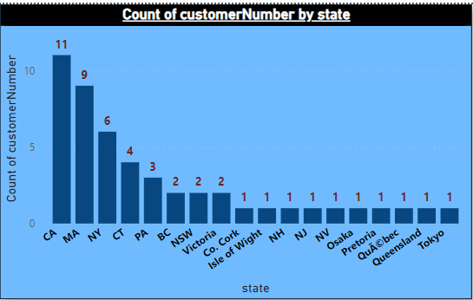
What is the correlation between customer demographics and purchase frequency?
Within the depths of our analysis, a compelling revelation takes center stage: Customers hailing from states like CA, MA, and NY, nestled within the EMEA and NA markets, emerge as dominant players, commanding a significant share of our market percentage. Their purchasing prowess is unmistakable.
It is in these thriving territories that the tide of purchasing power surges, and the USA, in particular, stands tall as a beacon of prosperity. Our conclusion is crystal clear: the purchasing power of these top-tier countries, spearheaded by customers from CA, MA, and NY, charts a course toward a flourishing horizon, defining our path to enduring success.

Slide 23
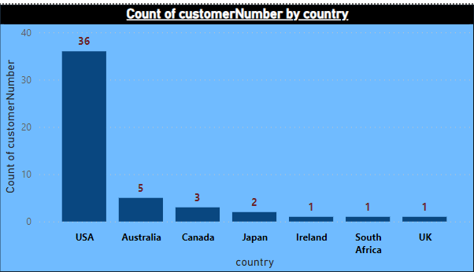
What is the correlation between customer demographics and purchase frequency?
Our analysis paints a vivid portrait of customer influence, with states like CA, MA, and NY emerging as commanding forces in the EMEA and NA markets. Their substantial market share dwarfs that of others, revealing a significant increase in purchasing power.
It's a compelling narrative that underscores the profound contribution of these top states. As we chart our course forward, we're drawn to the undeniable allure of the USA, where purchasing power soars. The story is clear: customer influence reigns supreme in these regions, promising a future rich with opportunity and growth.

Slide 24
What is the correlation between customer age and purchase frequency?
Analyzing the correlation between customer age and purchase frequency requires sufficient data that captures both age and purchase frequency for a meaningful analysis and report. Unfortunately, without access to this data, it is not possible to determine the correlation or draw any conclusions. A robust dataset with age information and a record of purchase frequency is essential to perform such an analysis effectively. If you obtain the necessary data in the future, you can then proceed with the correlation analysis and reporting.

Slide 25

EDA Problem Statements

Slide 26
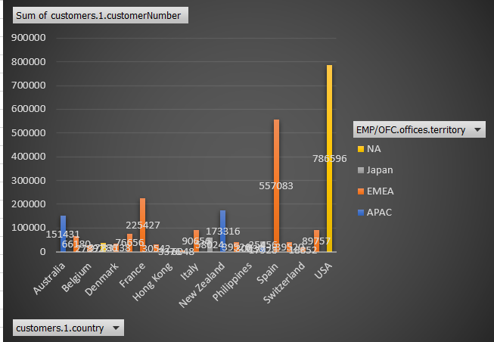
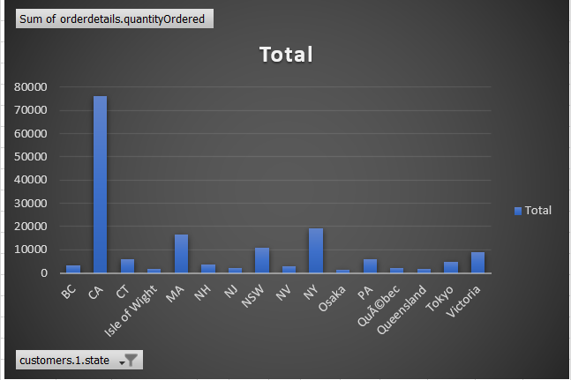
Which factors contribute to the highest sales in a particular region?
Based on our in-depth analysis and insightful findings, several key factors stand out as potent drivers behind the attainment of the highest sales in a particular region:
Buy Price Optimization: Careful consideration and optimization of buy prices have emerged as a critical factor. Striking the right balance between competitive pricing and profitability significantly impacts sales performance.
Strategic Location: The geographic positioning of our operations within the region plays a pivotal role. A well-chosen location can enhance accessibility, reduce logistical costs, and boost sales.
Customer Prediction and Insights: The ability to accurately predict customer needs and behaviour is paramount. Leveraging data-driven insights allows us to tailor products, marketing strategies, and customer experiences, resulting in higher sales.
These factors, as revealed by our meticulous analysis, represent the cornerstone of our success in driving the highest sales within the specific region. They underscore the importance of precision and strategic decision-making in our pursuit of sales excellence.

Slide 27
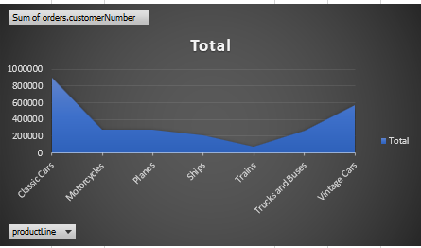
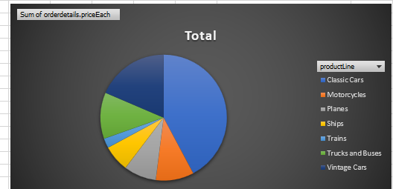
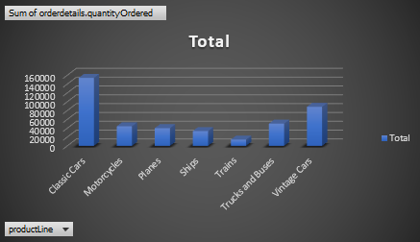
How can customer purchasing patterns be influenced to increase average order value?
Purchasing patterns are the lifeblood of our strategy for elevating order values, serving as a dynamic window into market trends. By meticulously studying these patterns, we gain profound insights into which product categories command the highest orders—a priceless asset that fuels our business growth.
With these insights at our disposal, we're empowered to curate a dedicated category brimming with products that have consistently demonstrated robust sales over time. It's akin to crafting a treasure trove that aligns perfectly with customer preferences and market dynamics—a surefire recipe for capturing higher order values and propelling our business to new heights.

Slide 28
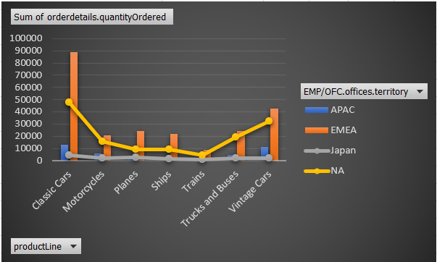
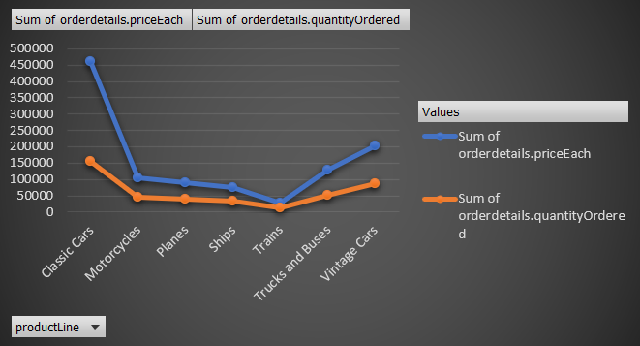
What are the key drivers of sales growth, and how can they be leveraged for future success?
Our analysis shines a spotlight on the remarkable growth trajectory of the Cars category, a true standout that commands over 50% of our total sales across categories. Notably, the order quantity mirrors this impressive trend, soaring to new heights within the Cars category.
A deeper dive into our report unveils an optimistic revelation—the growth trajectory of Cars is poised to align closely with our target aspirations. This alignment extends its reach across all markets, with North America (NA) and Europe, Middle East, and Africa (EMEA) offering promising avenues for expansion.
Our strategic compass points to a future where we execute tailored strategies across markets, leveraging the potent potential of each category to drive sales to new heights. This dynamic approach promises not only to fortify the growth of Cars but also to catalyze sales growth across all markets, setting the stage for a prosperous future.

Slide 29
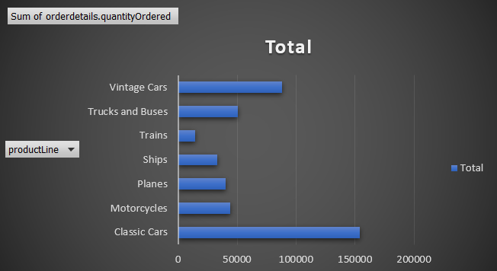
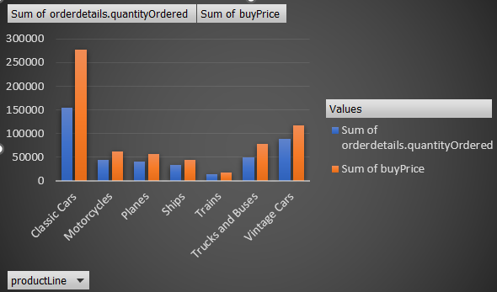
Which product features or attributes are most appealing to customers?
Our analysis uncovers a remarkable trend—Cars emerge as the driving force, contributing over 50% to the total sales across categories. This standout category not only commands a significant share of sales but also boasts a remarkable order quantity ratio.
Delving deeper into the report analysis reveals an exciting prospect—Cars are on the cusp of achieving their target growth. This optimistic outlook extends across all markets, offering a tantalizing opportunity to execute our strategies to perfection.
By strategically focusing on Cars as our main feature, we unlock the potential for substantial growth not only in existing markets but also in untapped territories. This calculated move promises to elevate our sales trajectory across the board, setting the stage for a brighter future.

Slide 30
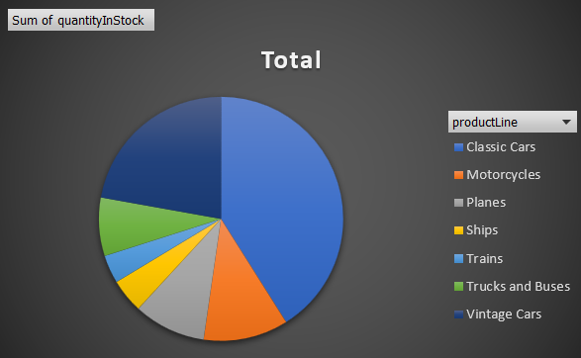
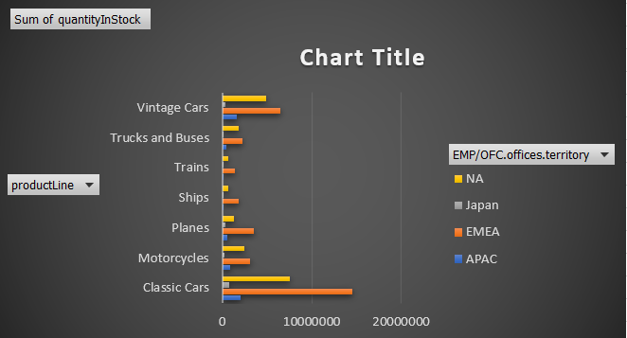
How can the product mix be optimized to cater to changing market demands?
The essence of our project lies in the art of product mix optimization—an indispensable technique that harmonizes perfectly with the ever-changing tides of market demand. Our analysis and report affirm the efficacy of this strategy, illuminating the path to fortified production and capitalization within specific markets.
In our journey, we embark upon a dual-pronged approach. Firstly, we meticulously segment our customer base, peering into the very DNA of demographics, buying behaviours, and preferences. This process unveils the most valuable customer segments, allowing us to craft a product mix that speaks directly to their unique needs and desires.
Secondly, we engage in a perpetual dance with the product life cycle, evaluating where each product stands—whether in the introduction, growth, maturity, or decline phase. This assessment guides our allocation of resources, channeling our efforts toward products poised for growth.
And as the heartbeat of our strategy, we establish a cadence of regular product mix reviews and assessments. This ensures that our product offerings remain attuned to the ever-evolving symphony of changing market demands.
In this intricate dance of data and strategy, we find the rhythm of optimization—a melody of success that promises to echo through our project, elevating our capitalization and fortifying our market presence.

Slide 31
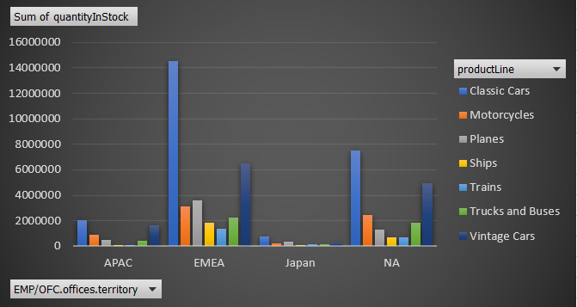
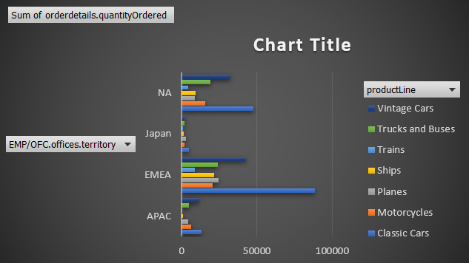
Are there any specific market segments where a particular product is underperforming, and how can it be improved? Within the contours of our analysis, a distinctive pattern emerges: the Japan market, a confluence of rich culture and innovation, appears to be the outlier, with no single product commanding a significant performance.
However, drawing concrete conclusions remains elusive, and we tread cautiously. It's plausible that the demand for our products in the Japan market may be relatively low compared to other regions. This unique market dynamic prompts us to embrace an inquisitive stance, seeking to unearth the underlying factors that influence consumer preferences in this region.
To improve performance in Japan, a path of exploration beckons—a journey that entails deeper market research, customer engagement, and cultural insights. By bridging the gap between our offerings and the discerning tastes of the Japanese market, we aspire to carve a niche for our products and breathe life into this untapped potential.
The quest is not merely to adapt but to thrive, to transform a challenge into an opportunity, and to orchestrate a symphony where every note resonates with success.

Slide 32
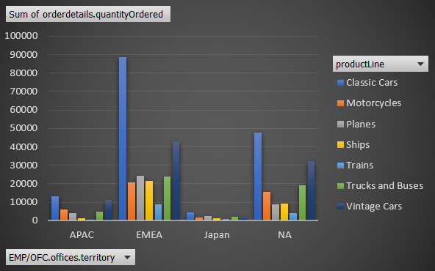
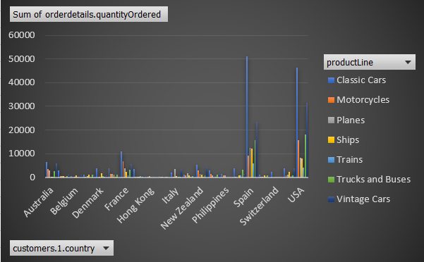
What are the main factors that influence customer loyalty and repeat purchases?
Customer loyalty and repeat purchases are fueled by a triumvirate of trust, quality, and service—the pillars of enduring customer relationships.
Trust: Like a steadfast bond, trust forms the foundation. Customers who believe in the brand's integrity and reliability are more likely to return.
Quality: Quality shines as the guiding star. Consistently superior products or services establish credibility and draw customers back for more.
Service: Exceptional service acts as the glue. Customers who experience outstanding support and care are inclined to stay loyal and make repeat purchases.
In this trinity of factors, we find the keys to fostering customer loyalty and ensuring a harmonious cycle of repeat business.

Slide 33
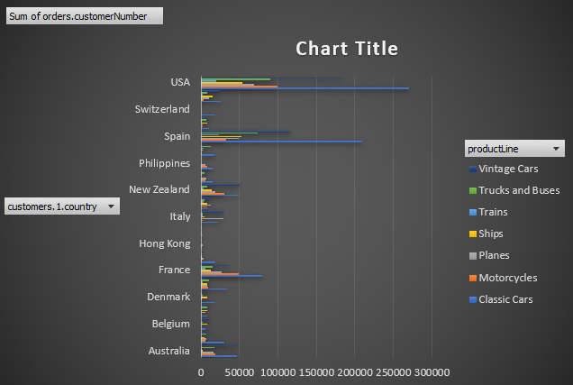
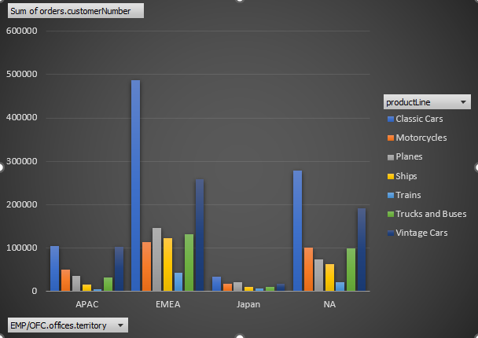
How do customer preferences differ based on geographic location, and how can marketing campaigns be customized accordingly?
Our analysis illuminates a fascinating dynamic—customer preferences exhibit distinct variations based on geographic location. Notably, the EMEA and NA regions emerge as pivotal influencers in our business landscape, bearing substantial weight. Similarly, countries such as the USA, Spain, and France stand as reliable pillars of production and revenue.
In response to these findings, a tailored marketing strategy beckons—one that dedicates focused campaigns to regions and countries beyond our current strongholds. By doing so, we unlock the potential for growth in untapped markets, casting our net wider and embracing the diversity of global consumer preferences.
In this strategic approach, we embrace the art of localization, crafting campaigns that resonate with the unique tastes, needs, and cultural nuances of each region. It's a journey that promises to expand our footprint, foster customer engagement, and ultimately chart a path to new horizons of success.

Slide 34
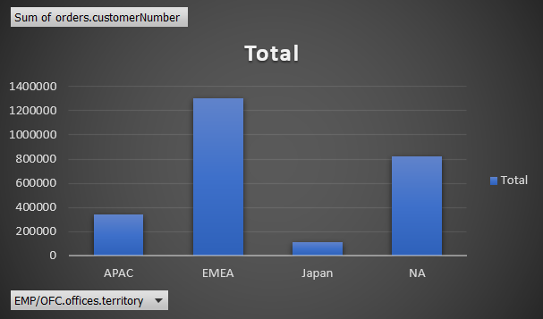
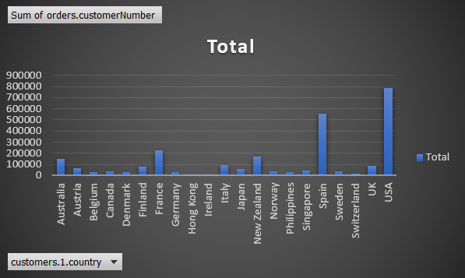
What are the characteristics of high-value customers, and how can similar customers be targeted for acquisition?
High-value customers, the gems of our business, often share common characteristics that distinguish them from the rest. As revealed by our analysis, these valued patrons tend to hail from top countries, such as the USA, Spain, and France. They are instrumental in propelling our business growth.
The characteristics that define high-value customers encompass not only their geographic origin but also their buying behaviours, brand loyalty, and propensity for repeat business. They are discerning, often seeking quality and reliability in their purchases.
To target similar customers for acquisition, we pivot our focus towards regions that demonstrate a propensity for fostering such high-value relationships. The EMEA and NA markets, with their abundance of customers, represent fertile grounds for cultivating these connections. By aligning our strategies and resources with these promising markets, we aim to replicate the success we've enjoyed with our high-value customers, ultimately driving growth and prosperity for our business.

Slide 35
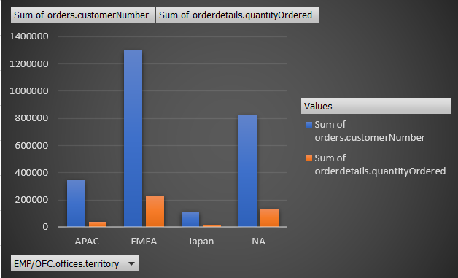
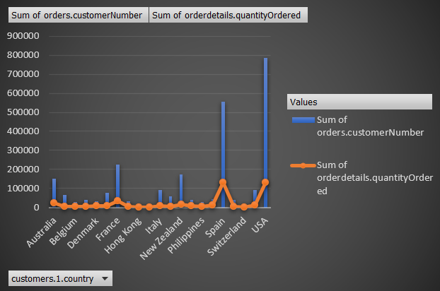
How can marketing strategies be tailored to target specific demographic segments in different regions?
MARKET ANALYSIS
COUNTRY WISE ANALYSIS

Slide 36
Tailoring marketing strategies to target specific demographic segments in different regions, including EMEA, Japan, NA (North America), and APAC (Asia-Pacific), requires a nuanced approach. Here's how it can be done:
1. EMEA Region:
Segmentation: Identify key demographic segments within the EMEA region, such as age, gender, income, and interests.
Localization: Customize marketing content, language, and imagery to resonate with the cultural and linguistic diversity of the European, Middle Eastern, and African countries.
Geo-Targeting: Use geo-targeted advertising to reach audiences in specific countries within the EMEA region.
2. Japan:
Cultural Sensitivity: Understand and respect Japanese cultural nuances in marketing materials, messaging, and visuals.
Personalization: Japanese customers value personalized experiences. Implement data-driven personalization in marketing efforts.
Mobile Optimization: Japan has a strong mobile culture. Ensure mobile-friendly marketing campaigns.
3. NA (North America):
Demographic Targeting: Segment the diverse North American market by demographics, including age, ethnicity, and income.
Multi-Channel Marketing: Utilize various channels, from social media to TV advertising, to reach a broad audience.
Seasonal Campaigns: Tailor campaigns to align with regional seasons, holidays, and events.
4. APAC Region:
Cultural Diversity: Recognize the vast cultural diversity across Asia-Pacific countries. Adapt marketing messages to each culture.
Mobile-First Approach: APAC has a strong mobile user base. Optimize marketing for mobile devices and messaging apps.
Local Partnerships: Collaborate with local influencers and businesses for authenticity and reach.
5. Specific Countries:
Market Research: Conduct in-depth research on each country's consumer behaviour, preferences, and trends.
Regulatory Compliance: Be aware of and adhere to local regulations and standards for advertising and marketing.
Localized Content: Create content that speaks to the specific needs and aspirations of customers in each country.

Slide 37
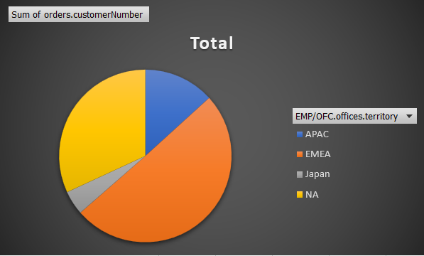
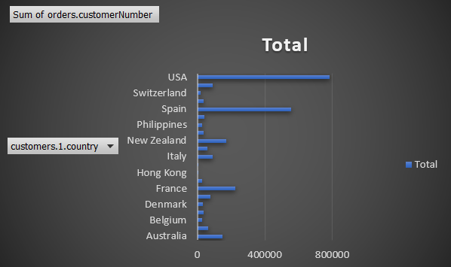
What are the potential untapped markets based on demographic indicators, and how can market penetration be increased?
Region Analysis
Country Analysis

Slide 38
Unlocking potential untapped markets based on demographic indicators, spanning the EMEA, APAC, and NA regions, holds the promise of expanded market penetration and growth.
1. EMEA Region:
- Eastern Europe: Explore emerging markets with growing populations and rising disposable incomes.
- Middle East: Target affluent segments in countries like Saudi Arabia and the UAE, leveraging their strong purchasing power.
2. APAC Region:
- Southeast Asia: Tap into the youthful populations of countries like Indonesia, Vietnam, and the Philippines, where smartphone adoption is high.
- India : With a massive and diverse population, India offers vast untapped potential, especially in e-commerce and technology.
3. NA (North America):
- Hispanic Market: Customize marketing campaigns for the growing Hispanic demographic, which represents a significant consumer base.
- Canada: Explore opportunities in Canada, a market often overshadowed by the larger U.S. market.
To increase market penetration in these untapped markets:
Market Research: Conduct thorough research to understand local demographics, preferences, and buying behaviour.
Localized Marketing: Tailor marketing strategies to align with the unique characteristics of each region and demographic segment.
Local Partnerships: Collaborate with local businesses, influencers, and distributors to establish credibility and reach.
Digital Presence: Optimize online presence, including mobile and social media, to connect with tech-savvy consumers.
Product Adaptation: Modify products or services to meet the specific needs and preferences of the target demographic.
Customer Engagement: Foster engagement through customer support, feedback, and loyalty programs.
By strategically targeting these untapped markets and implementing region-specific tactics, businesses can unlock new avenues for growth and significantly increase market penetration.

Slide 39
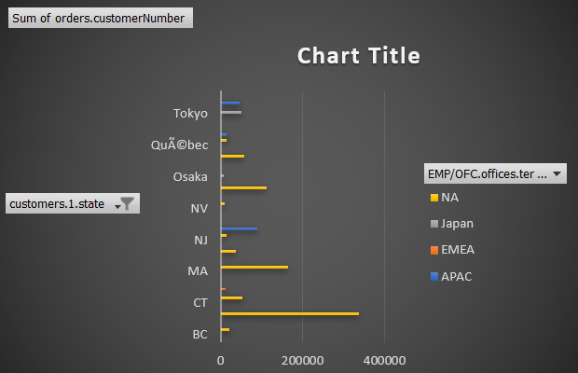
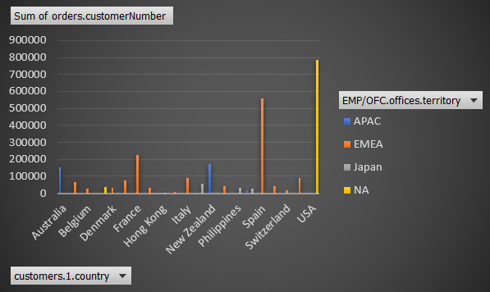
How do customer preferences and behaviour differ based on demographic factors, and how can they be leveraged for personalized marketing campaigns?

Slide 40
Customer preferences and behaviour are profoundly influenced by demographic factors, and leveraging this understanding can power personalized marketing campaigns that resonate deeply. Our analysis spotlights two significant markets: EMEA and APAC, which command the highest order ratios among all markets. Additionally, specific states, such as California and New York, emerge as key players.
1. Demographic Factors:
Age : Younger demographics often seek trendy and innovative products, while older demographics may prioritize quality and reliability.
Gender : Preferences can vary based on gender, influencing product choices and messaging.
Income : Higher income levels may lead to a preference for premium or luxury products.
Location : Geographic factors, such as urban vs. rural, can shape preferences and needs.
Cultural Background : Cultural nuances can influence choices, from dietary preferences to fashion.
2. Leveraging for Personalized Marketing:
Segmentation : Use demographic data to segment customers into groups with similar preferences and behaviours.
Content Customization : Tailor marketing content, imagery, and language to resonate with specific demographics.
Product Recommendations : Utilize recommendation engines to suggest products based on past behaviour and demographic indicators.
Localization : Localize marketing campaigns to align with regional and cultural preferences.
Promotions : Offer promotions and discounts that align with the budget and income level of the target demographic.
Customer Engagement : Engage with customers from specific demographics through targeted social media campaigns and surveys.
By embracing the rich tapestry of customer demographics, we unlock the potential for deeply personalized marketing campaigns. EMEA and APAC markets, along with key states, serve as vibrant canvases where these strategies can flourish, fostering stronger customer connections, engagement, and ultimately, higher order ratios.

Slide 41
Thank You Very Much

